Slide 1

PRoJEct benson
Brain Juice Marketing Project

Slide 2
The problem: product trial placement
Metis team -
It was great chatting with you at the recent BeverageLovers meetup. We’d love to take some next steps to see if working together is something that would make sense for both parties.
As we mentioned, we are affiliated with Diageo International, a leading beverage producer, and we have a new drink we are bringing to market in Q3 2015. The target audience for this new drink, "Brain Juice," are young striving professionals who are working hard, burning the candle at both ends, and need an edge to make sure both their brains and bodies are fully powered when it counts most. Gender is not important, but we believe that our target customers should best trial this product in a very specific time window - either in early the morning (to fuel up on the way to work), or in the late afternoon / early evening (to fuel up for the gym, happy hour, or the club).
We believe the best way to find these customers for a sample trial will be the use of street teams, who will set up table with Brain Juice product samples, offer testers coupons for additional Brain Juice purchases, and collect customer contact information for our monthly "Be the Brain of tomorrow" newsletter, full of tips for tomorrow's aspiring professional.
We would like to engage you to harness the power of data and analytics to optimize the deployment of our street teams near subway stations - it's a big city, so where should we locate our teams to engage the largest number of customers? If possible, we also want to ensure that customer have a good experience with Brain Juice, so we'd like to avoid long lines if possible. I've heard that the MTA makes subway ridership data available, so maybe you can look into this as a tool for this work?
The ball is in your court now—do you think this is something that would be feasible for your group? From there we can explore what kind of an engagement would make sense for all of us.
Best,
Dr. Jennifer J Pepper
Diageo International
Client: Diageo
New Beverage: “Brain Juice”
Target customer: “Young striving professionals who are burn the candle at both ends”
The strategy: AM/PM product trial
Early AM: (fuel up on the way to work, school, or the gym)
Late PM: (to fuel up for the gym, happy hour, or the club).
Deliverable: recommendations on where to deploy street teams for product trial near subway stations

Slide 3
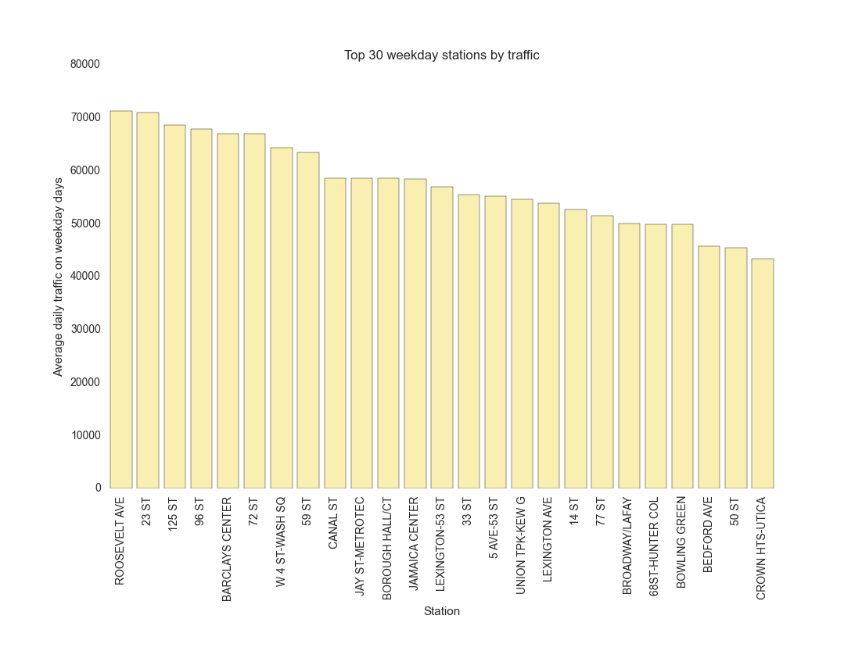
Largest stations: weekday
Stations with the largest weekday traffic are Roosevelt Ave, 23St, 125St, 96st

Slide 4
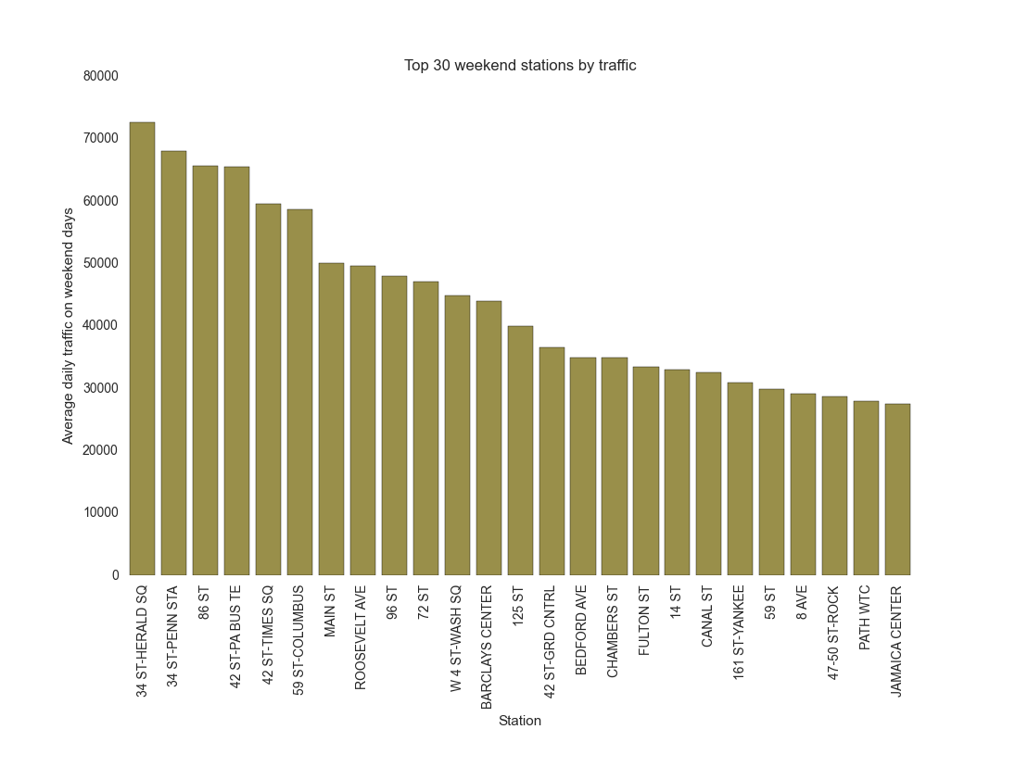
Largest station: weekend
Stations with the largest weekend traffic are 34st-HeraldSq, 34st-Penn, 66st, 42st

Slide 5
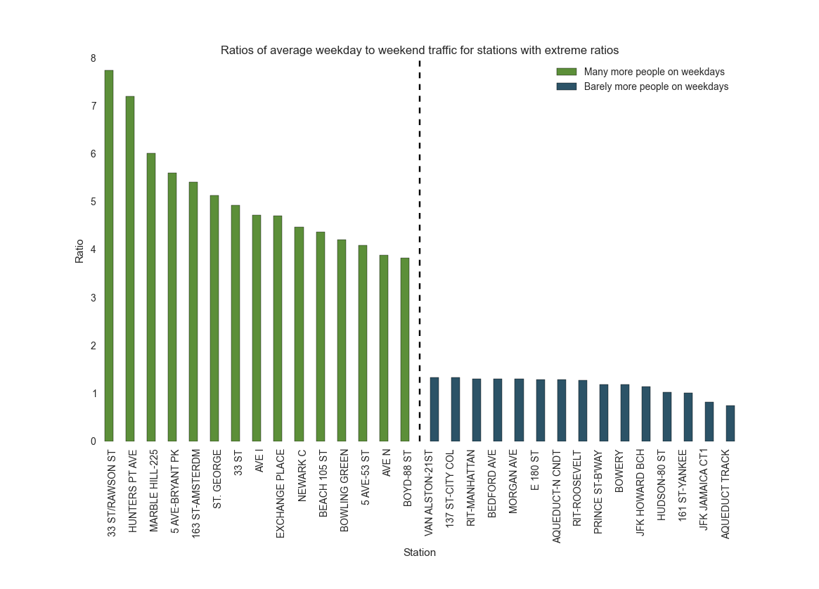
Weekday vs. Weekend Ratio
Commuting Stations: 33St-RawsonSt, HuntersPtAve, MarbleHill
Touristy Stations: Stations AcqueductPark, JFK-Jamaica, 161-Yankee

Slide 6
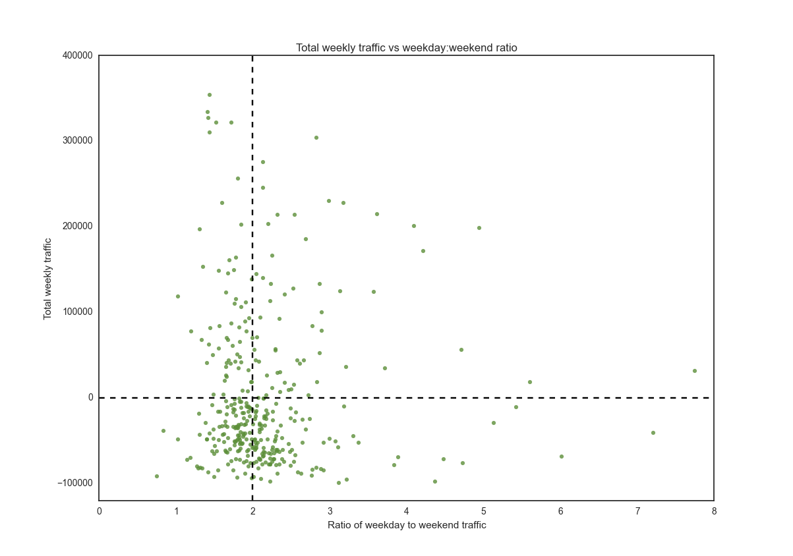
Overall Traffic vs. Commuterness
4St-WashSq
Kiosks?
Large volume
Mixed traffic
Mobile teams?
Large volume
High commuter traffic
Commuterness (Rank(
weekday / weekend)
33St
Small volume
Mixed traffic
Solo solicitor?
Small volume
High commuter traffic
Rank (Total Traffic)

Slide 7
Takeaways and next steps
Mta data alone can help identify target consumer groups
Stations with high percentage of commuters
Stations with high traffic
Stations with consistent 7-day traffic
Next steps / suggestions for improvement
Other variability measures (morning vs evening, inter-week)
Should cross-check with how many vendors are at target stations

